Slide 1
Health Economics
Chapter 3: Health Capital - Short

Slide 2
Grossman Theory of Health Capital
Health can be viewed as both a consumption and an investment good.
A consumption good is one that is purchased to satisfy the needs and wants of an individual (being healthier makes you feel better)
An investment good can be thought of one where costs are paid up front and gains are collected in the future. (Higher earnings for healthier, more productive workers).
We begin by modeling health as an investment good.

Slide 3
Conceptual Framework
Grossman (1972) “On the Concept of Health Capital and the Demand for Health”
Health care and time spent doing healthy activities can be thought of as inputs into the production of good health.
Better health means you have more “healthy days,” which are days that you can work and earn income.
Without health care and “healthy time,” health deteriorates, or depreciates.
→ Money spent on health care and the opportunity cost of healthy time can be thought of as investments that pay dividends in the future by way of increased earnings.

Slide 4
Example
A car:
provides a stream of services over time (travel) which can be used
to produce income (getting to work, or even doing work as a cabbie) or
utility (pleasure trips)
Regular maintenance is required to prevent against depreciation
Your level of investment in your car today depends on how much you discount the future.
The depreciation rate depends on how hard you drive the car

Slide 5
Car Example Continued
The optimal running condition (which determines performance/reliability) depends on :
the cost of a typical trip to the mechanic
the marginal value of another trip to the mechanic in terms of overall running condition
the rate of depreciation
The rate at which you discount the future.

Slide 6
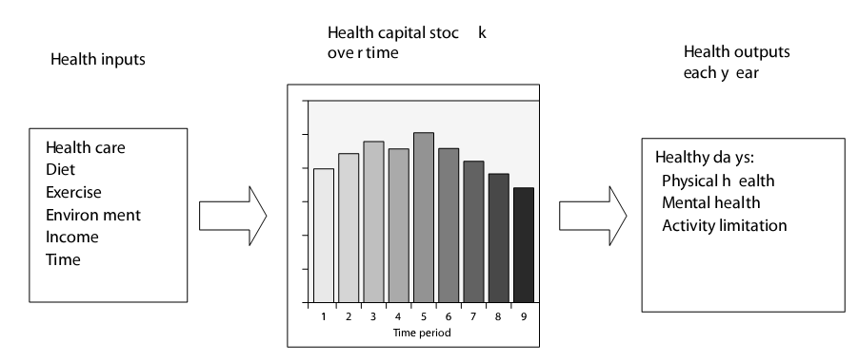
Health Capital Investment Theory
It is helpful to think of the demand for health as an investment in human capital.
Let’s think of investing in a capital good, i.e., a good that is used in the production of some output.

Slide 7
Empirical Studies: What Factors Affect MEC?
Note: Grossman empirically found the opposite correlation between income level and health. Why might this be?
Answer: He failed to control for lifestyle…higher incomes may be associated with unhealthy lifestyles
He didn’t isolate the wage effect – he needed to keep hours worked constant
The model predicts a positive relation between health care spending and health capital, the data show a negative relationship.
Lags in health investments and health outcome could be the answer (see Galamata and Kapteyn (2009)).

Slide 8
Empirical Studies: What Factors Affect MEC?
Others have found an inverse relationship between health and upturns in the US business cycle!!!!
Same effect for developing countries?

Slide 9
Are Bad Times Healthy?
How do business cycle fluctuations affect health?

Slide 10
Are Bad Times Healthy?
Based on NY-Times article from 10/07/08
Long-term economic gains lead to improvements in a population’s overall health (both in industrialized and developing countries), BUT …
People tend not to take care of themselves in boom times
drinking too much (especially before driving),
dining on fat-laden restaurant meals,
skipping exercise, doctors’ appointments, time with their children because of work-related time commitments
people experience more stress in boom times?
Similar patterns have been seen in some developing nations (e.g. high coffee prices correlated with bad health)

Slide 11
“Are Recessions Good For Your Health?”
Christopher Ruhm, The Quarterly Journal of Economics, 2000, vol. 115, issue 2, pages 617-650
Total mortality and eight of the ten sources of exhibit pro-cyclical fluctuation (suicide is the only exception)
Some evidence that the unfavorable health effects of temporary upturns are partially or fully offset if the economic growth is long-lasting
Smoking and obesity increase when the economy strengthens
Physical activity is reduced and diet becomes less healthy

Slide 12
Are Bad Times Healthy? (2)
Japan in the 1990s
Unemployed were twice as likely to be in poor health than those with secure jobs
Peru’s economic crisis 1980s:
Infant mortality increased 2.5 percentage points
Individuals born in a recession were at higher risk for heart problems later in life and lived, on average, 15 months less than those born under better conditions
Poor economic conditions can also cause stress that may interfere with parent bonding and childhood development

Slide 13
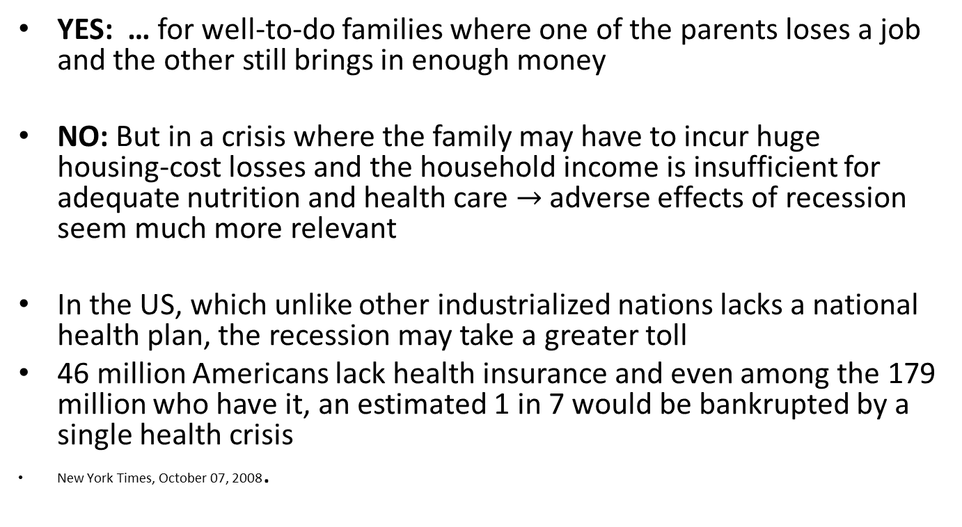
Are Bad Times Good for your Health? Conclusion?
YES: … for well-to-do families where one of the parents loses a job and the other still brings in enough money
NO: But in a crisis where the family may have to incur huge housing-cost losses and the household income is insufficient for adequate nutrition and health care $→$ adverse effects of recession seem much more relevant
In the US, which unlike other industrialized nations lacks a national health plan, the recession may take a greater toll
46 million Americans lack health insurance and even among the 179 million who have it, an estimated 1 in 7 would be bankrupted by a single health crisis
New York Times, October 07, 2008.

Slide 14
Other Impacts of Education
Demand Side Explanation:
More educated people may enjoy healthy food more
They know more about dangers of smoking, etc.
Decrease depreciation rate
Rate of time preference (spurious correlation)
Effects of education are strong, especially mother’s education
A study of the impact of sanitary systems and better sources of water in Bangladesh and Indonesia revealed that neither appeared to significantly affect child survival rates, but parent’s wealth and education were very important

Slide 15
Other Factors Empirically Correlated with Health
Positive
Being married, especially among men (psoriasis goes down as does alcoholism);
Increased leisure time (Elasticity between 0.25-0.65)
Negative
Age
Urbanization
Being overweight
On a final note, be aware that the model does not incorporate the fact that disease hits at random times (uncertainty) and that uncertainty might have an impact on optimal health levels

